Slide 1
Ellipsoidal Calculations for the Center of a Circular Arc

Slide 2
Key differences
Old Method
New Method
Works with a unit sphere centered at the origin for all cases
Does not consider the eccentricity of the Earth
Requires iteration for accuracy
Works with points in 3D space, essentially approximating with a different sphere for each set of given points
Performs straight computations with no iteration required

Slide 3
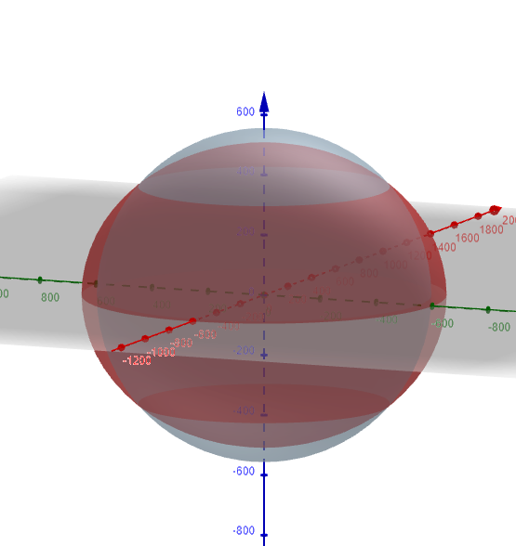
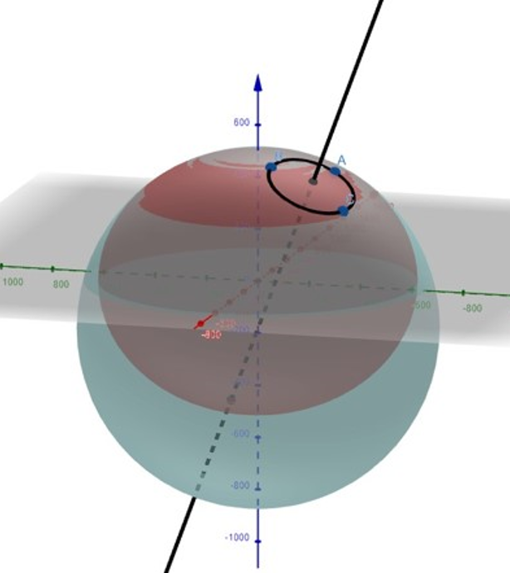

Slide 4
A Couple Numerical Examples

Slide 5
Less than 50 km
Can be up to 200x more accurate
0.0001 cm vs 0.02 cm
Usually no more than 10x

Slide 6
50 km
Given the points:
(40.1826445599023°, -100.535912381856°)
(39.9040234165676°, -99.4283297988790°)
(40.3413069610291°, -100.382894290765°)
Old method yields:
(39.9999945915752, -99.9999998671073)
Error of 60 cm
New method yields:
(40.0000004444979, -99.999999858067)
Error of 2 cm
New method is 30x more accurate

Slide 7
50 km
Given the points:
(40° 10' 57.52042" N, 100° 32' 9.284570" W)
(39° 54' 14.48430" N, 99° 25' 41.98728" W)
(40° 20' 28.70506" N, 100° 22' 58.41945" W)
Old method yields:
(39° 59' 59.98053" N, 99° 59' 59.99952" W)
Error of 60 cm
New method yields:
(40° 00' 00.00160" N, 99° 59' 59.99949" W)
Error of 2 cm
New method is 30x more accurate

Slide 8
100 km
Given the points:
(14.2367152905056, 169.502963298686)
(15.8379740065487, 169.651135071546)
(15.7721226718491, 169.515938783772)
Old method yields:
(14.9999880701915, 169.99999826348)
Error of 2 m
New method yields:
(15.0000000192027, 169.999998586087)
Error of 1 cm
New method is 200x more accurate

Slide 9
100 km
Given the points:
(14° 14' 12.17505" N, 169° 30' 10.66788" E)
(15° 50' 16.70642" N, 169° 39' 04.08626" E)
(15° 46' 19.64162" N, 169° 30' 57.37962" E)
Old method yields:
(14° 59' 59.95705" N, 169° 59' 59.99375" E)
Error of 2 m
New method yields:
(15° 00' 00.00007" N, 169° 59' 59.99491" E)
Error of 1 cm
New method is 200x more accurate

Slide 10
500 km
Given the points:
(-80.5498815935815, -57.9855177638926)
(-73.6534011776292, -73.5298046432850)
(-82.4175284238271, -73.5793410145355)
Old method yields:
(-77.9997605380793,-77.9999932378592)
Error of 50 m
New method yields:
(-78.000000185732,-78.0000015658538)
Error of 0.6 cm
New method is 8000x more accurate

Slide 11
500 km
Given the points:
(80° 32' 59.57374" S, 57° 59' 07.86395" W)
(73° 39' 12.24424" S, 73° 31' 47.29672" W)
(82° 25' 3.102330" S, 73° 34' 45.62765" W)
Old method yields:
(77° 59' 59.13794" S, 77° 59' 59.97566" W)
Error of 50 m
New method yields:
(78° 00' 00.00067" S, 78° 00' 00.00564" W)
Error of 0.6 cm
New method is 8000x more accurate

Slide 12
500 km
Given the points:
(-28.3053052351272, 49.7632297956831)
(-31.8183987572244, 40.2128050937594)
(-33.6645586323010, 48.0789814734054)
Old method yields:
(-29.9994647395339, 44.9999901462738)
Error of 70 m
New method yields:
(-29.9999960860945, 44.9999979480735)
Error of 50 cm
New method is 140x more accurate

Slide 13
500 km
Given the points:
(28° 18' 19.09885" S, 49° 45' 47.62726" E)
(31° 49' 06.23553" S, 40° 12' 46.09834" E)
(33° 39' 52.41108" S, 48° 04' 44.33330" E)
Old method yields:
(29° 59' 58.07306" S, 44° 59' 59.96453" E)
Error of 70 m
New method yields:
(29° 59' 59.98591" S, 44° 59' 59.99261" E)
Error of 50 cm
New method is 140x more accurate

Slide 14
1000 km
Given the points:
(48.3761832364168, -104.59052020541)
(42.5737708522071, -88.5490104984518)
(35.3611393749174,-109.730080302483)
Old method yields:
(39.9975188228862, -99.9998826550566)
Error of 400 m
New method yields:
(39.999977397425, -99.9999742739276)
Error of 4 m
New method is 100x more accurate

Slide 15
1000 km
Given the points:
(48° 22' 34.25965" N, 104° 35' 25.87274" W)
(42° 34' 25.57507" N, 88° 32' 56.43779" W)
(35° 21' 40.10175" N, 109° 43' 48.28909" W)
Old method yields:
(39° 59' 51.06776" N, 99° 59' 59.57756" W)
Error of 400 m
New method yields:
(39° 59' 59.91863" N, 99° 59' 59.90739" W)
Error of 4 m
New method is 100x more accurate

Slide 16
Other Notable Facts
Near the poles, results from new method can be up to 100x more accurate than the old method, however this is going from a tenth of a centimeter of error to a thousandth of a centimeter, so it is rather negligible.
The new method is barely more accurate near the equator.
This is because at the poles and equator, the sphere which best models the surface of the Earth would be centered at the origin

Slide 17
To Note
Near poles, more accurate, but negligible
Near equator, methods are fairly equal
Other cases are where difference can be seen

Slide 18
Thank you

